Slide 1

CISC-6100: Software Engineering
User Requirements
Functional requirements
Week 2 -- September 9

Slide 2
Outline for today’s class
Administrative items
Review of homework
Introduction to the class project
Intro to UML …
User case diagrams, use case scenarios
Process models
Homework assignment
Reading
Use case diagrams, use case scenarios
Project time

Slide 3
Administrative items
Please use email (or text) to contact me
Sending a message through Blackboard can take hours to get to me
Most weeks I will ask 3-5 students to present their homework
We have a wide range of software engineering experience; so I will need to teach to a level somewhere between the extremes:
If you feel you are falling behind or not understanding the class content, please see me and we can set up extra time to review (either in small groups or alone)
If you feel you are not being challenged, please let me know and we can set up ‘special’ assignments.

Slide 4
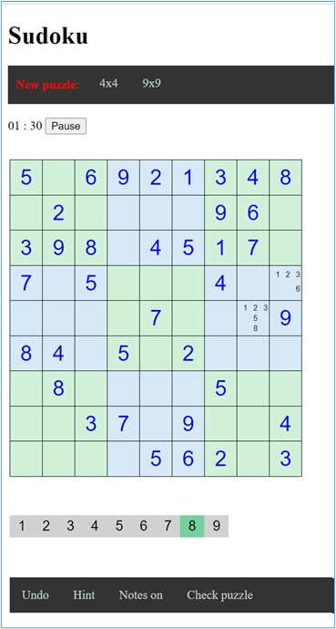
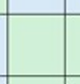
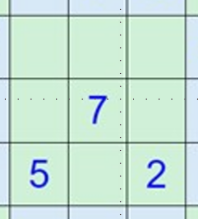
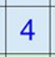
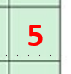
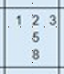
Terminology
Cell
Region or sub-grid
Given
User entered
Note
7
5
2

Slide 5
Review of homework
Overall, very good efforts and nice results on the storyboards and AI analysis!
Lots of creative results
Examples of some submissions follow:
In general, my (teacher/customer) feedback is applicable to many submissions, not just the ones shown.
You do not need to change your storyboard based on my customer feedback. It is just meant to show what a customer may say.
Moving forward your team can use the completed storyboard I have uploaded to Blackboard or agree on your own that supplies all the required functionality.

Slide 6
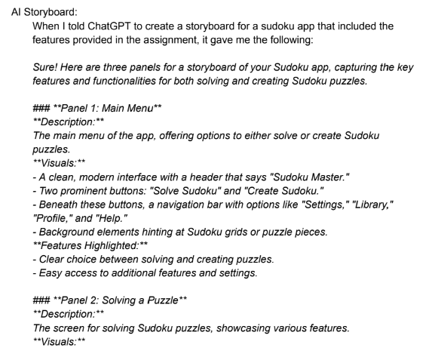
Review of homework - Use of AI: Vanessa
These panels provide a clear and user-friendly overview of the app’s features, guiding users through both solving and creating Sudoku puzzles with ease.
ChatGPT was somewhat helpful in developing the general tone and aesthetics of the app, as well as identifying key elements to somewhat improve functionality. However, without the ability to generate graphics, ChatGPT is unable to create a storyboard. I found it most useful as a way to check that my storyboard contained all the key elements of a functional sudoku app.
Overall, AI was of minimal help, and definitely could not complete the whole assignment.
…

Slide 7
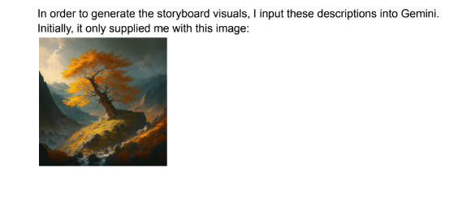
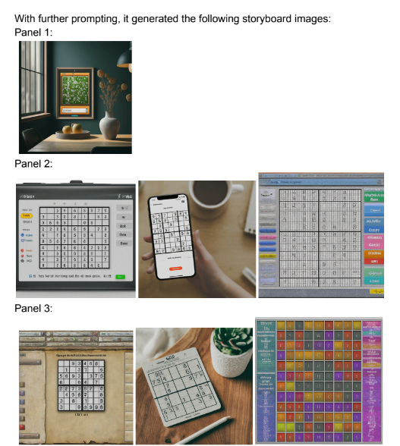
Review of homework - Use of AI: Vanessa
Gemini was legitimately useless when it came to creating a storyboard for this assignment. It was unable to replicate an actual sudoku board. It also failed to replicate any of the functionality that ChatGPT outlined or create visuals that corresponded with the ones given. Many of the images generated were not even adjacent to a sudoku board, and those that were adjacent failed to integrate any unique or appealing design elements.
…

Slide 8
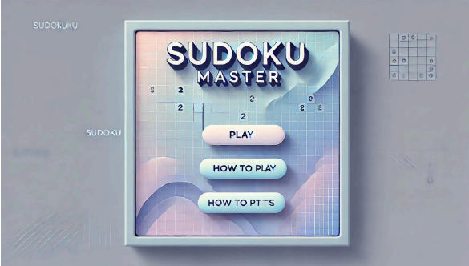
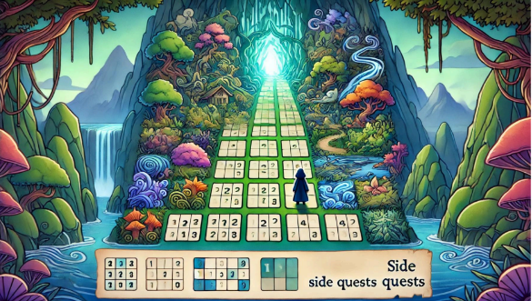
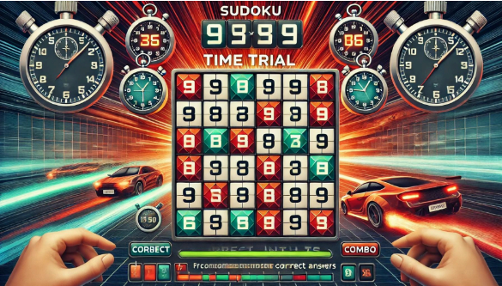
Review of homework - Use of AI: Jan Bierowiec
First attempt

Slide 9
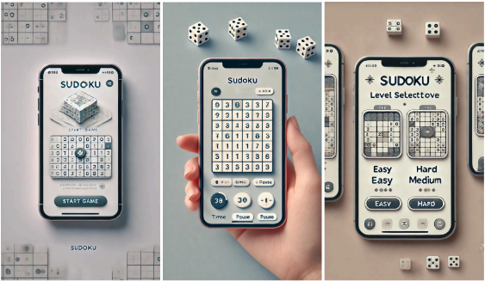
Review of homework - Use of AI: Jan Bierowiec
Third attempt …

Slide 10
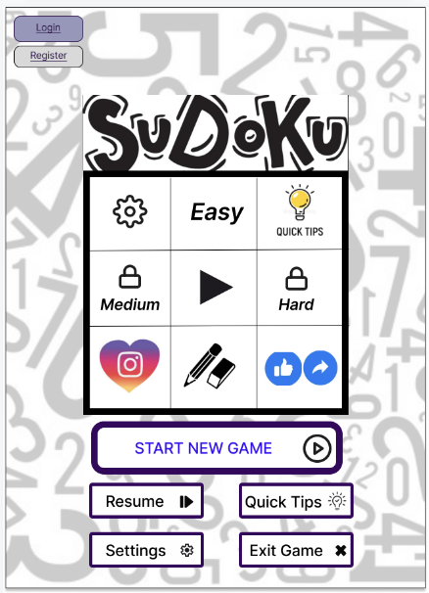
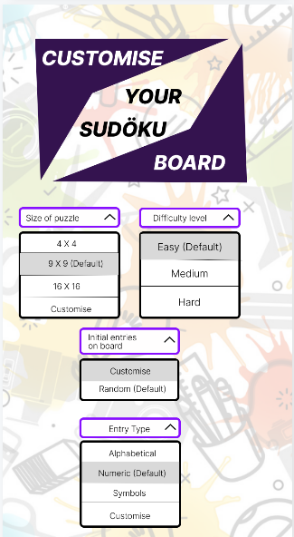
Review of homework - Storyboards: Prarthana

Slide 11
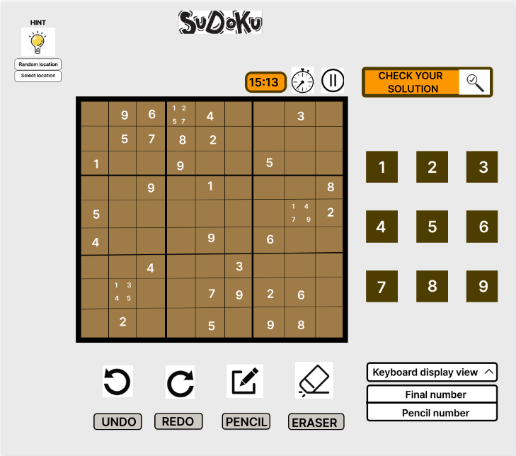
Review of homework - Storyboards: Prarthana
Plus two more showing start and finish.

Slide 12
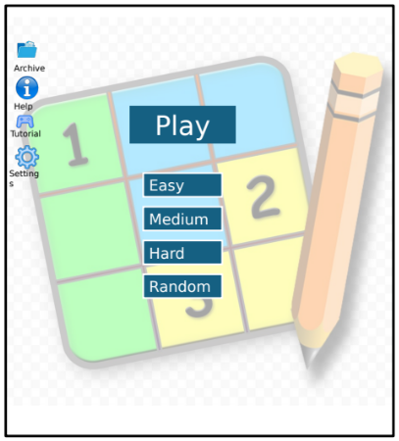
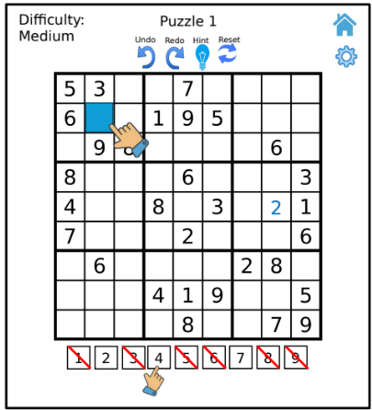
Review of homework - Storyboards: Danny
Plus start screen

Slide 13
This result and analysis shows and then makes conclusions approximating what most of you encountered/found:
Good step-by-step instructions
Some creative ideas on how to display information
Poor/no ability to visually represent information
Another weak point (at least with current technology) is that an AI does not yet replace the interaction between a customer and a client. In our homework you started with a written specification; a step the AI could not have generated.
Is the AI reasoning (thinking) and generating images?
Or is the AI just parsing your requests and searching for best results?

Slide 14
Any questions from the reading?

Slide 15
Introduction to class project
We will design and implement (parts of) a Sudoku puzzle creation and playing system.
The teaching goal of the project is to use it as an illustrative example of how go through a full product cycle from design through maintenance.
We will not actually build the full system; however, we will complete selected aspects. It should prove interesting to see how far we can get!
The project will involve team efforts and individual efforts.
You will be given some class time to work synchronously with your assigned team, but you will also need to do some work outside of class time, either asynchronously and/or synchronously.

Slide 16
Introduction to class project
Create a system that facilitates the following:
An app for users to solve Sudoku puzzles on. Features of which may include:
2-dimensional puzzles of various sizes:
9x9
4x4
16x16
Puzzles can be selected from a library or generated on demand
Puzzles can be selected from a library of already generated puzzles
Selectable difficulty levels
Ability to make notations
Check solution as far as completed
Undo last move
Undo until all mistakes gone
Get a random or specific hint
Timing solution
Multi-grid puzzles
An app for users to create Sudoku puzzles on. Features of which will include:
Creating grids of various sizes or selecting existing multi-grid layouts
Computer generated puzzles of specified difficulty
Use / define alternative representation to numeric entries
Does not need to be implemented, but must be considered in all design phases

Slide 17

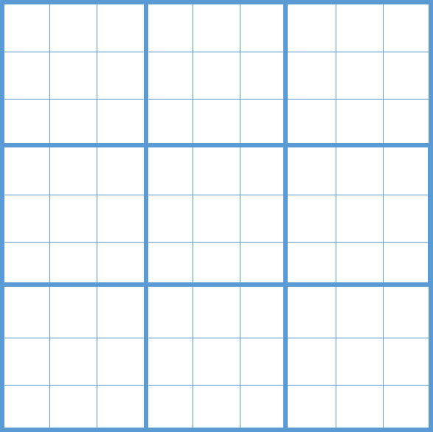
Sudoku Puzzle Playing/Designing App
Example of a 2 grid, multi-grid puzzle

Slide 18
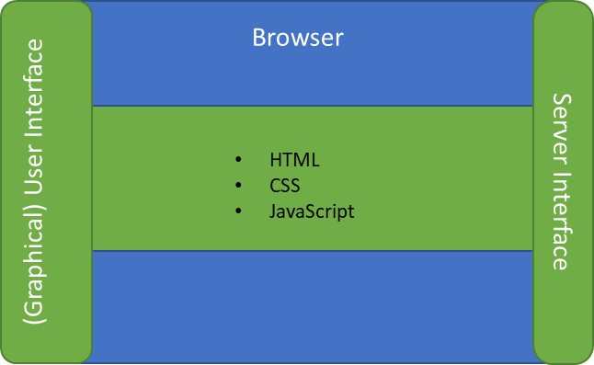
Sudoku – reference Architecture
Database
Internet
Graphical User Interface
(view)
JSON encoder/decoder
URL encoder
URL parser
State save/load
Browser
Server
JSON encoder/decoder
Sudoku engine
(controller)
HTML
CSS
JavaScript
http request
URL
JSON
Django
SQLite
Python
Sudoku representaton
(model)
http response
JSON

Slide 19
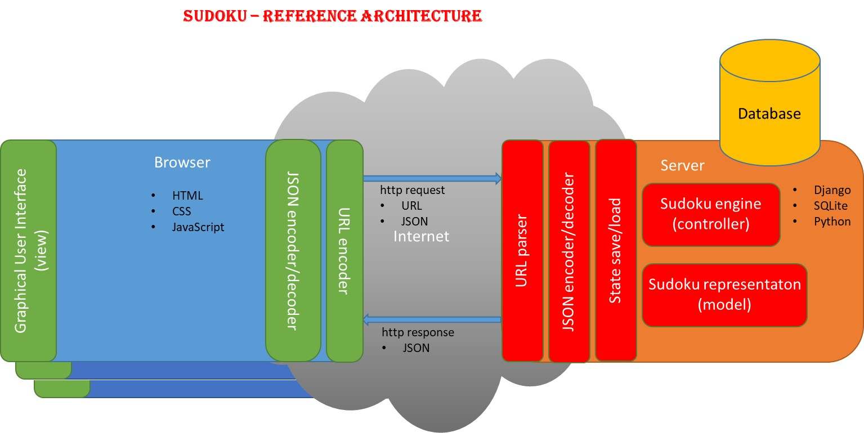
Web app:
Runs independent of a browser
Written in any language:
Swift, Java, C#, Rust, Python, …
Can get content from a server via URLs / APIs
Browser app:
Runs in a browser
Written in languages supported by browsers:
HTML, CSS, JavaScript, …
Can get content from a server via URLs / APIs
Static server: Upon receiving a request for specific static (already created) content via a URL, that content is returned and displayed in the form of: HTML, CSS, JavaScript, PDF, JPEG, etc.
Documents
Maps
Images
Dynamic server: Upon receiving a request for specific dynamic (created upon request) content via a URL, that content is returned and displayed in the form of: HTML, CSS, JavaScript, PHP, etc.
Filled in forms
Directions
Train schedule for a specific time and to/from stations

Slide 20
Optional storyboard for class project
Available on Blackboard in content folder “Design elements,” as “Storyboards.pptx”
Note use of:
Labelling
Annotations
Captions
so storyboards can be used standalone by customer

Slide 21
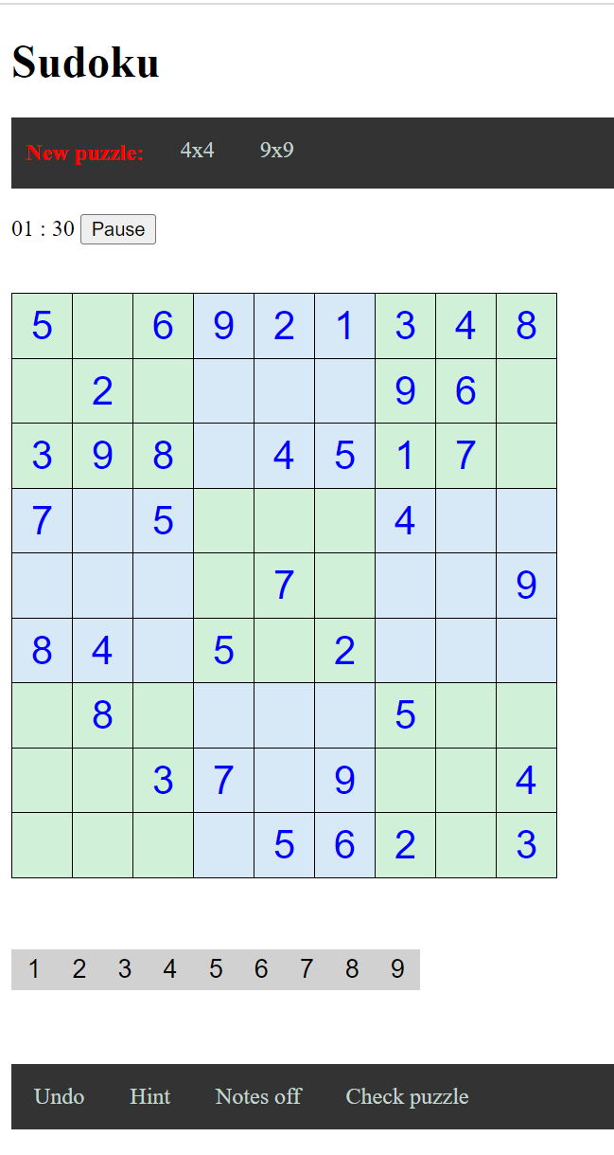

Home screen – appears when puzzle is instantiated:
A (random) 9x9 puzzle will be provided
The timer will be running
Normal play:
Select a value to enter
Value will be highlighted and stay active until new value is selected
Normal play:
Highlighted value will fill entry location selected
Normal play:
Provided entries are shown in blue and user entries are shown in black
7
7
7

Slide 22
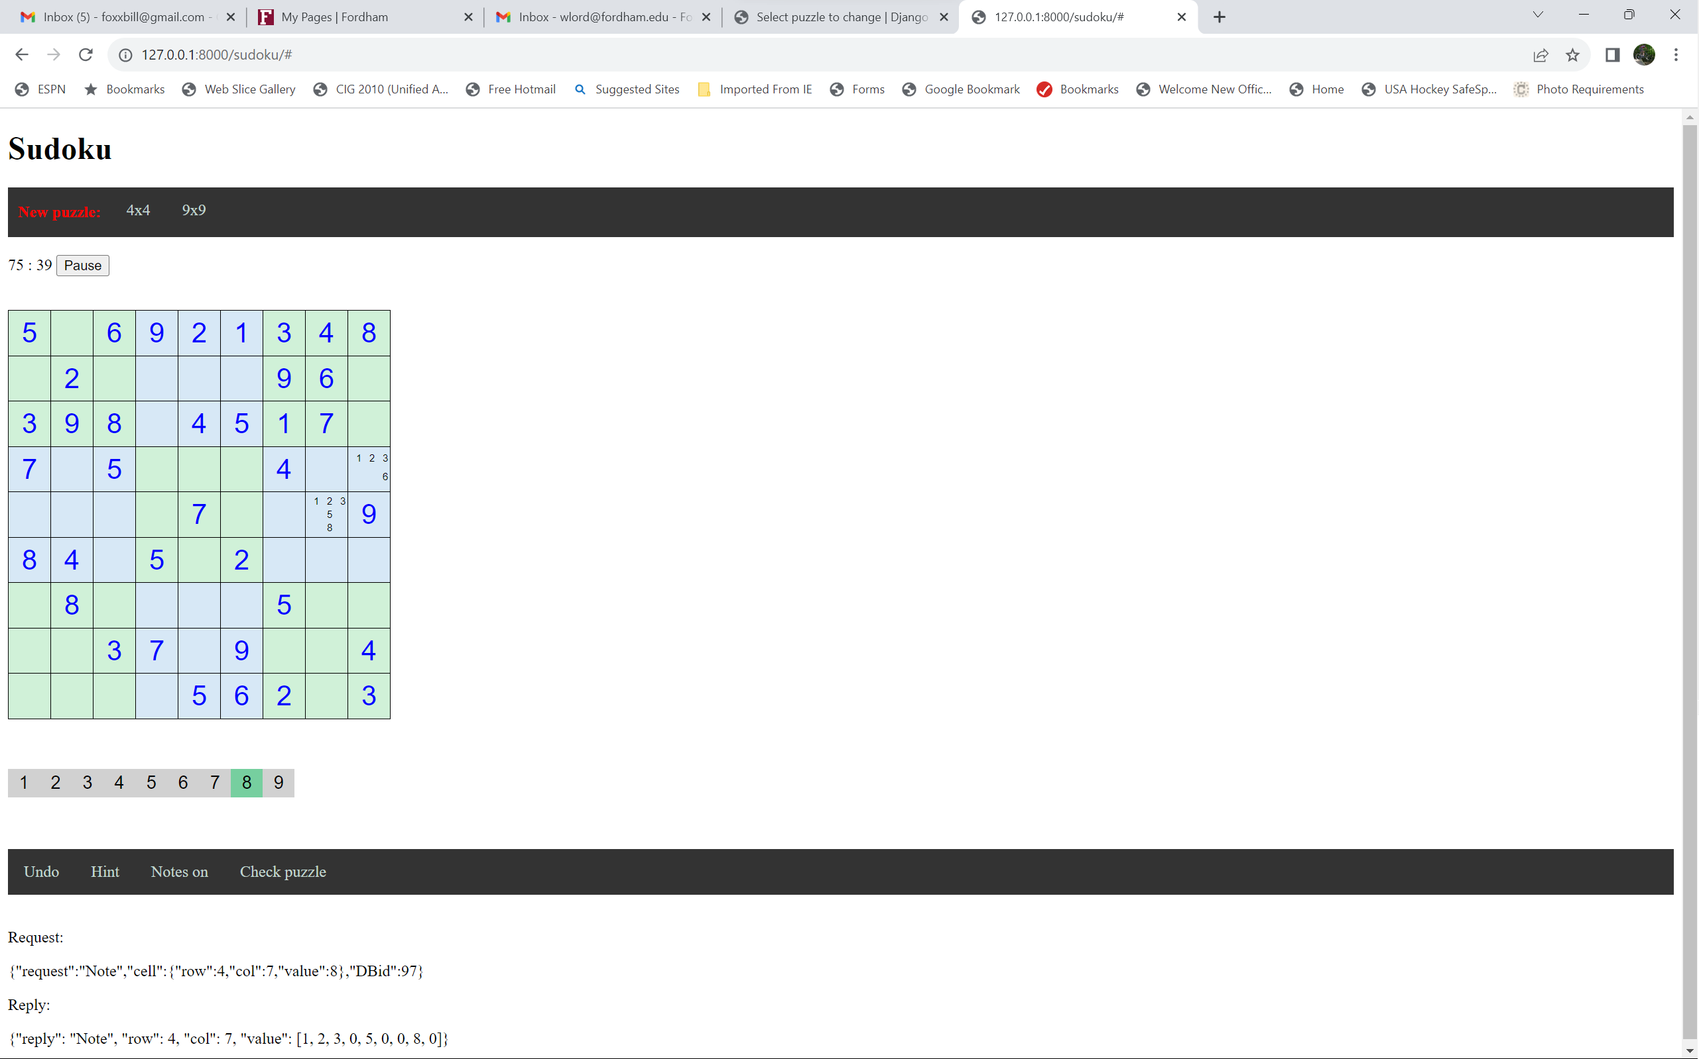
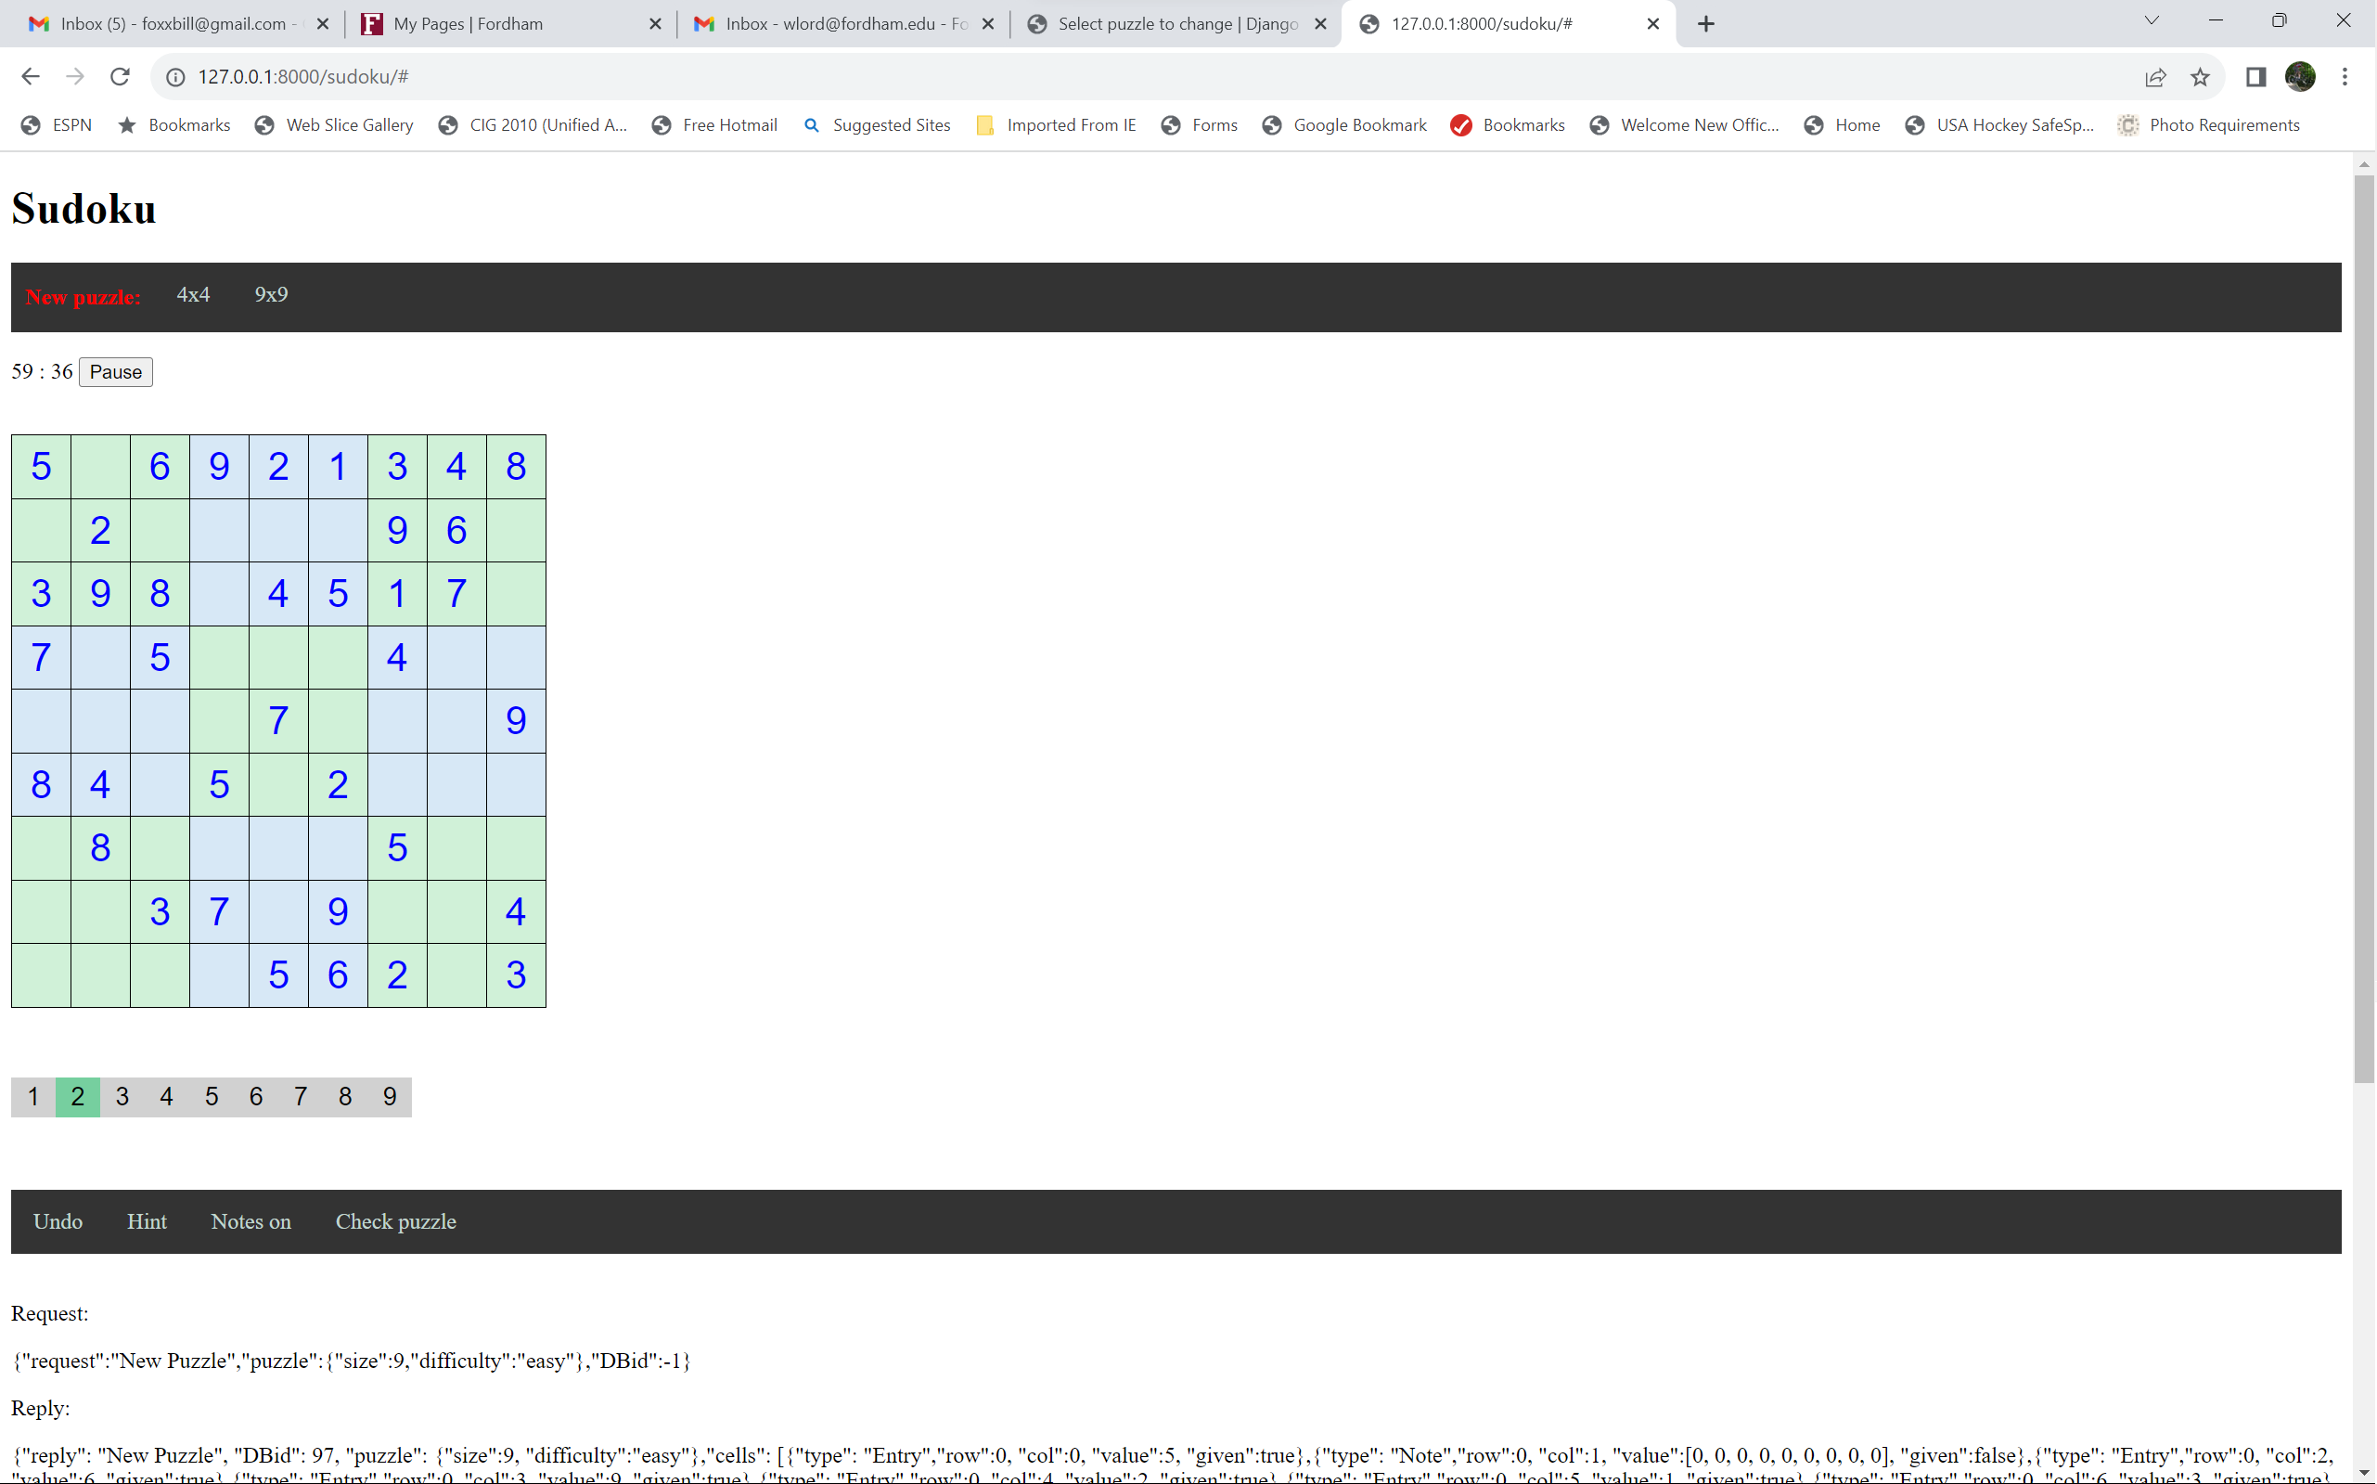
Notes mode:
Player can make notes of potential entries
Notes mode:
Value selected will be entered in location selected
Notes will override user entered values and vice-versa
Notes mode:
Highlighted value will fill entry location selected
Notes mode:
To remove an entry, enter it again (note entries toggle)
7
2
2
4

Slide 23
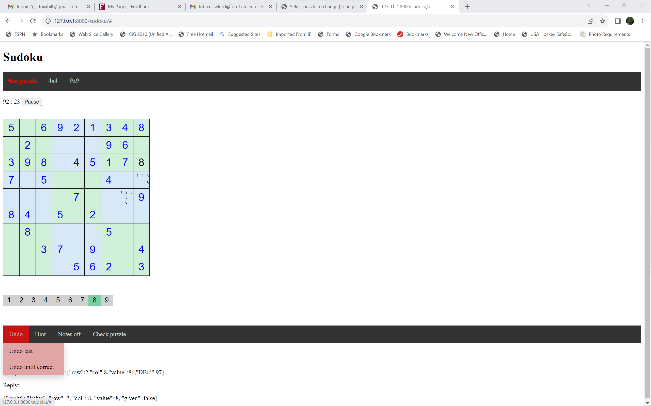
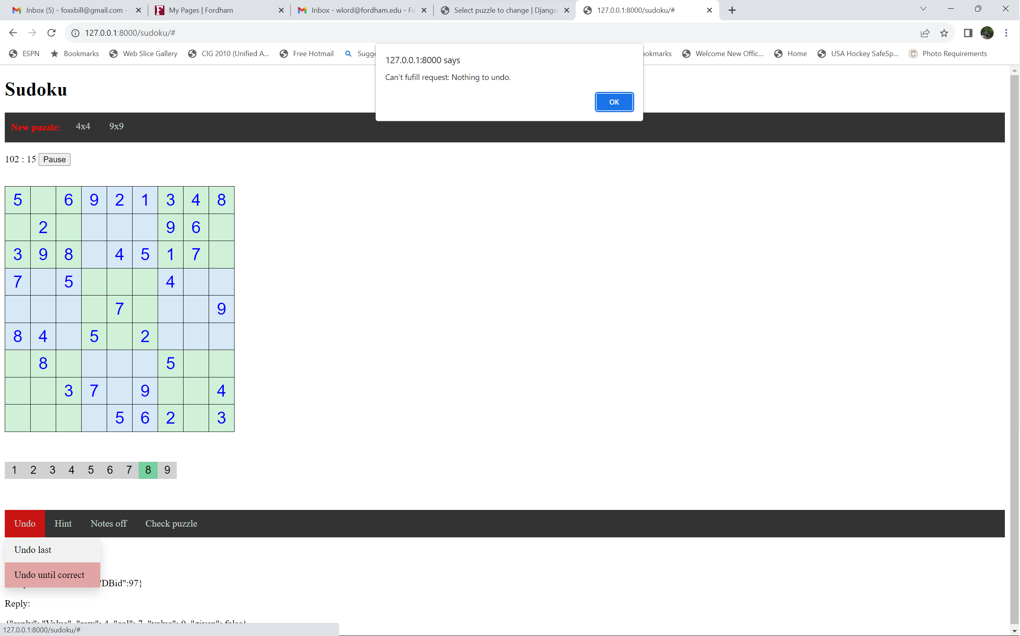
Undo (two types):
Undo last entry (value or note)
Undo all entries (including notes) until puzzle is correct
Undo last:
Can be repeated
Undo last:
Undoing past all user entered values (and/or notes) will show a warning

Slide 24
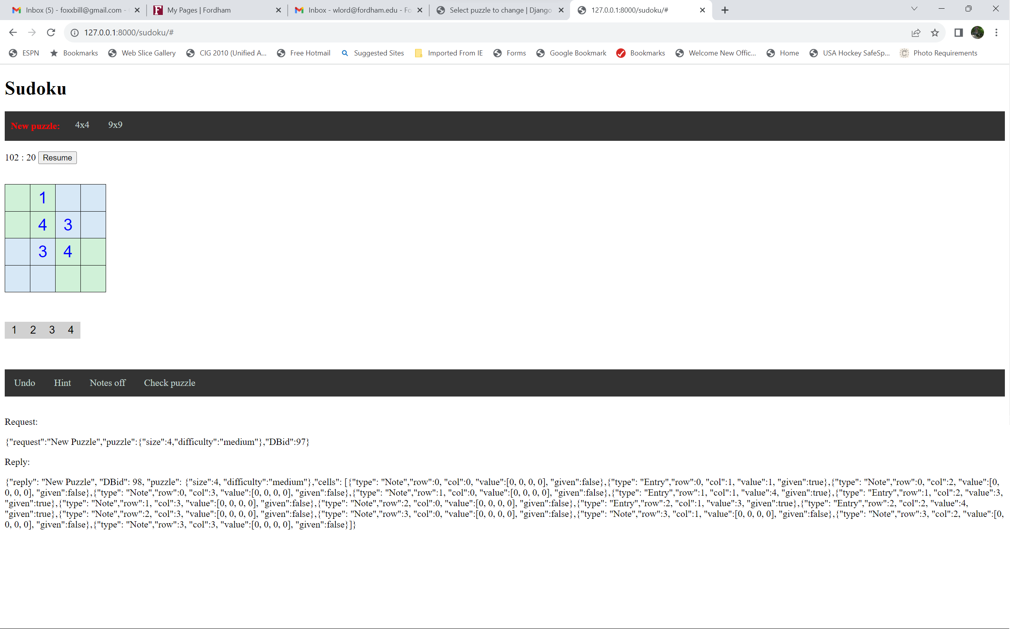
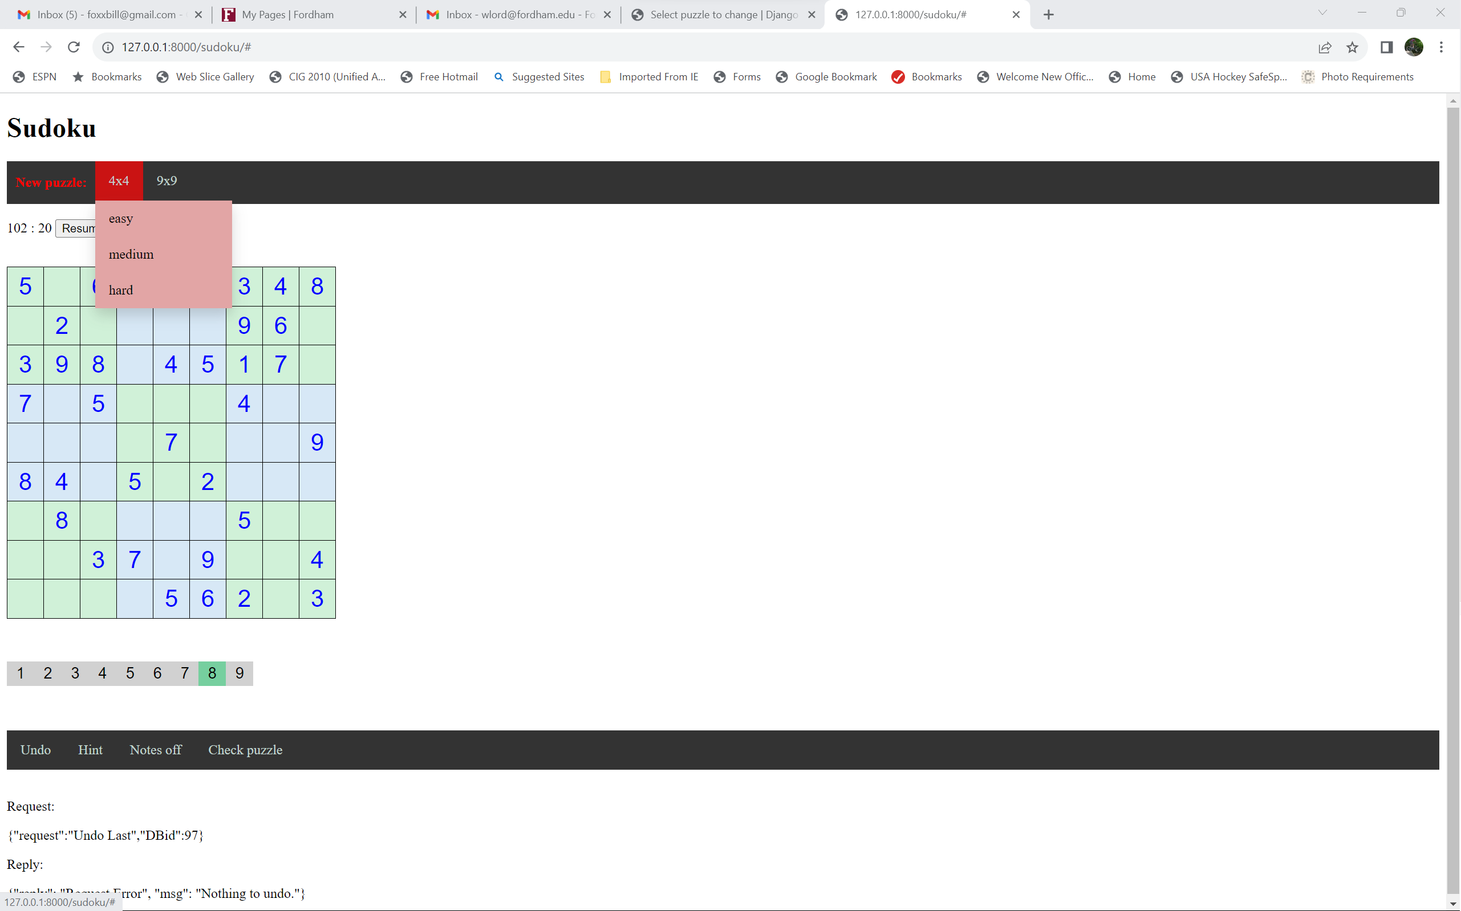
New puzzle:
Choose from 4x4 or 9x9
Choose difficulty
New puzzle:

Slide 25
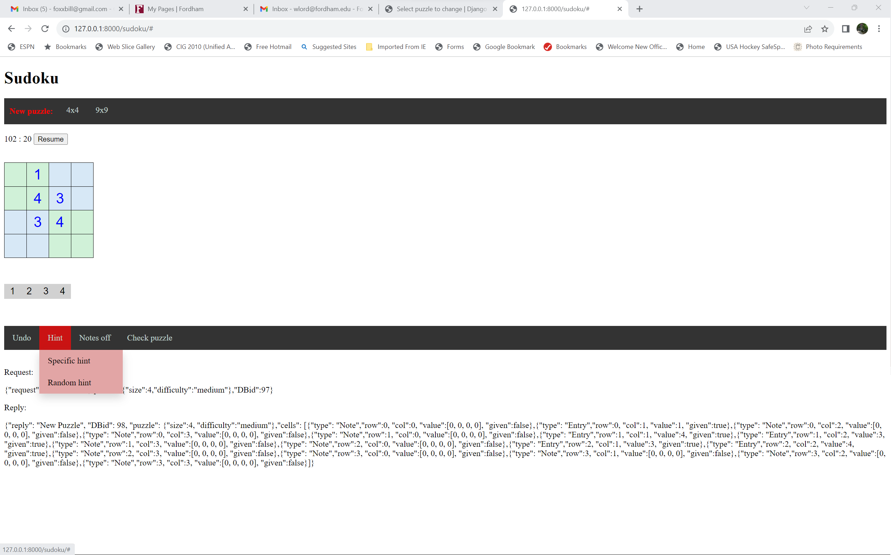
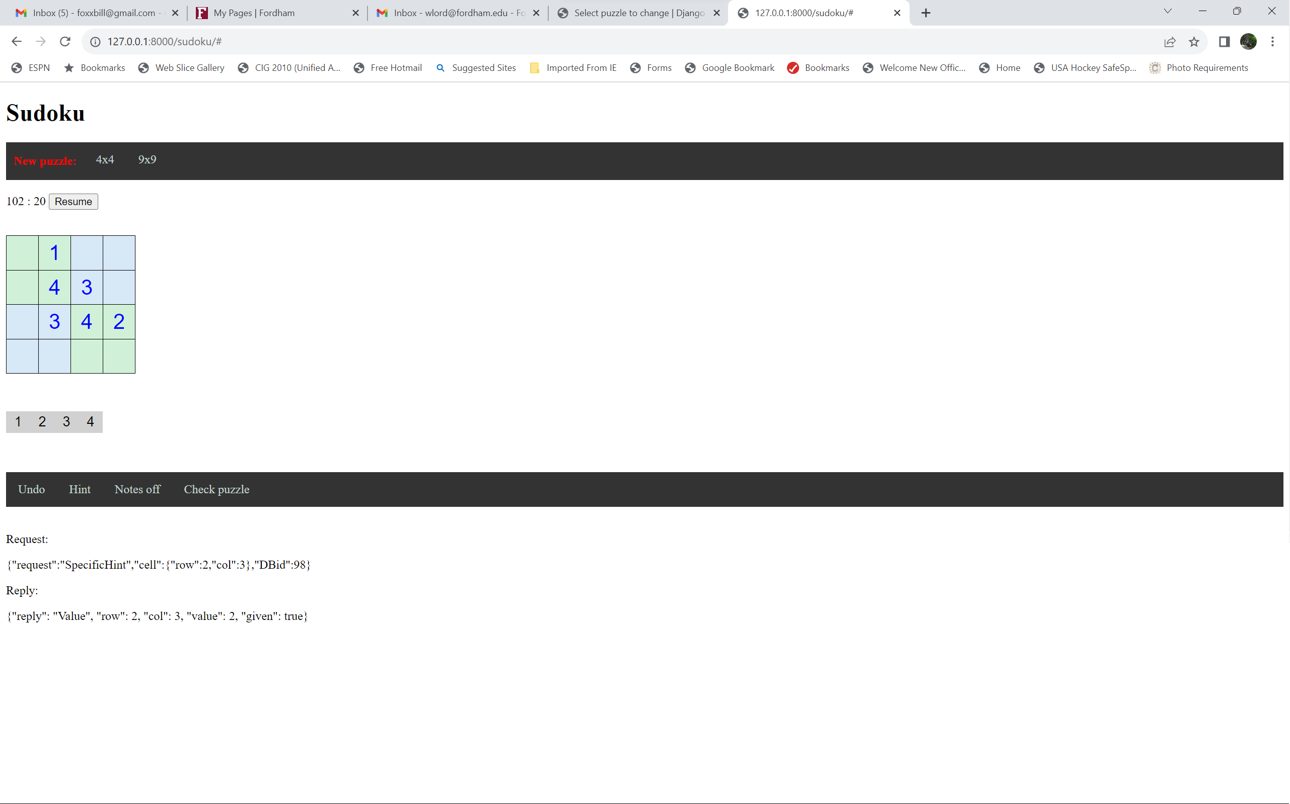
Hint (two types):
Choose location to get hint for
Get hint at a random location
Correction of an error
Hint at an empty location
Specific hint:
Select location
Specific hint:
Hint appears in blue and is now permanent

Slide 26
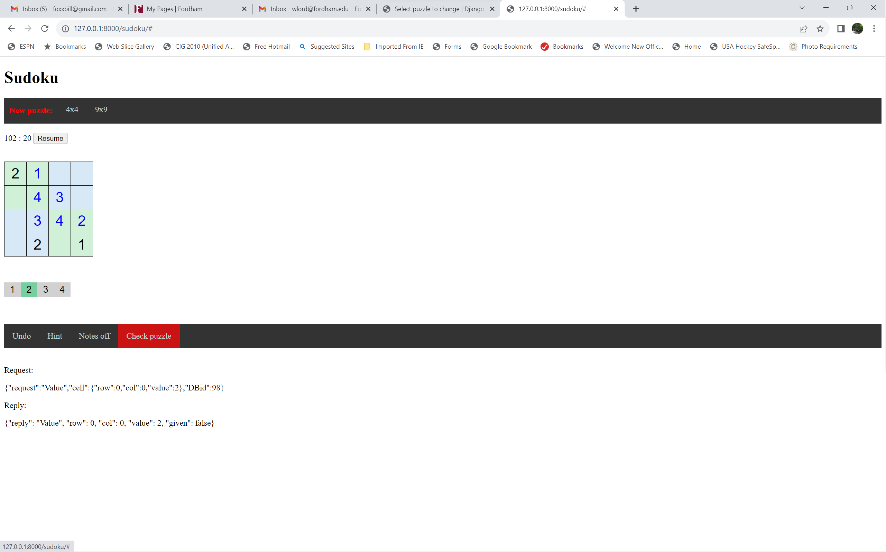
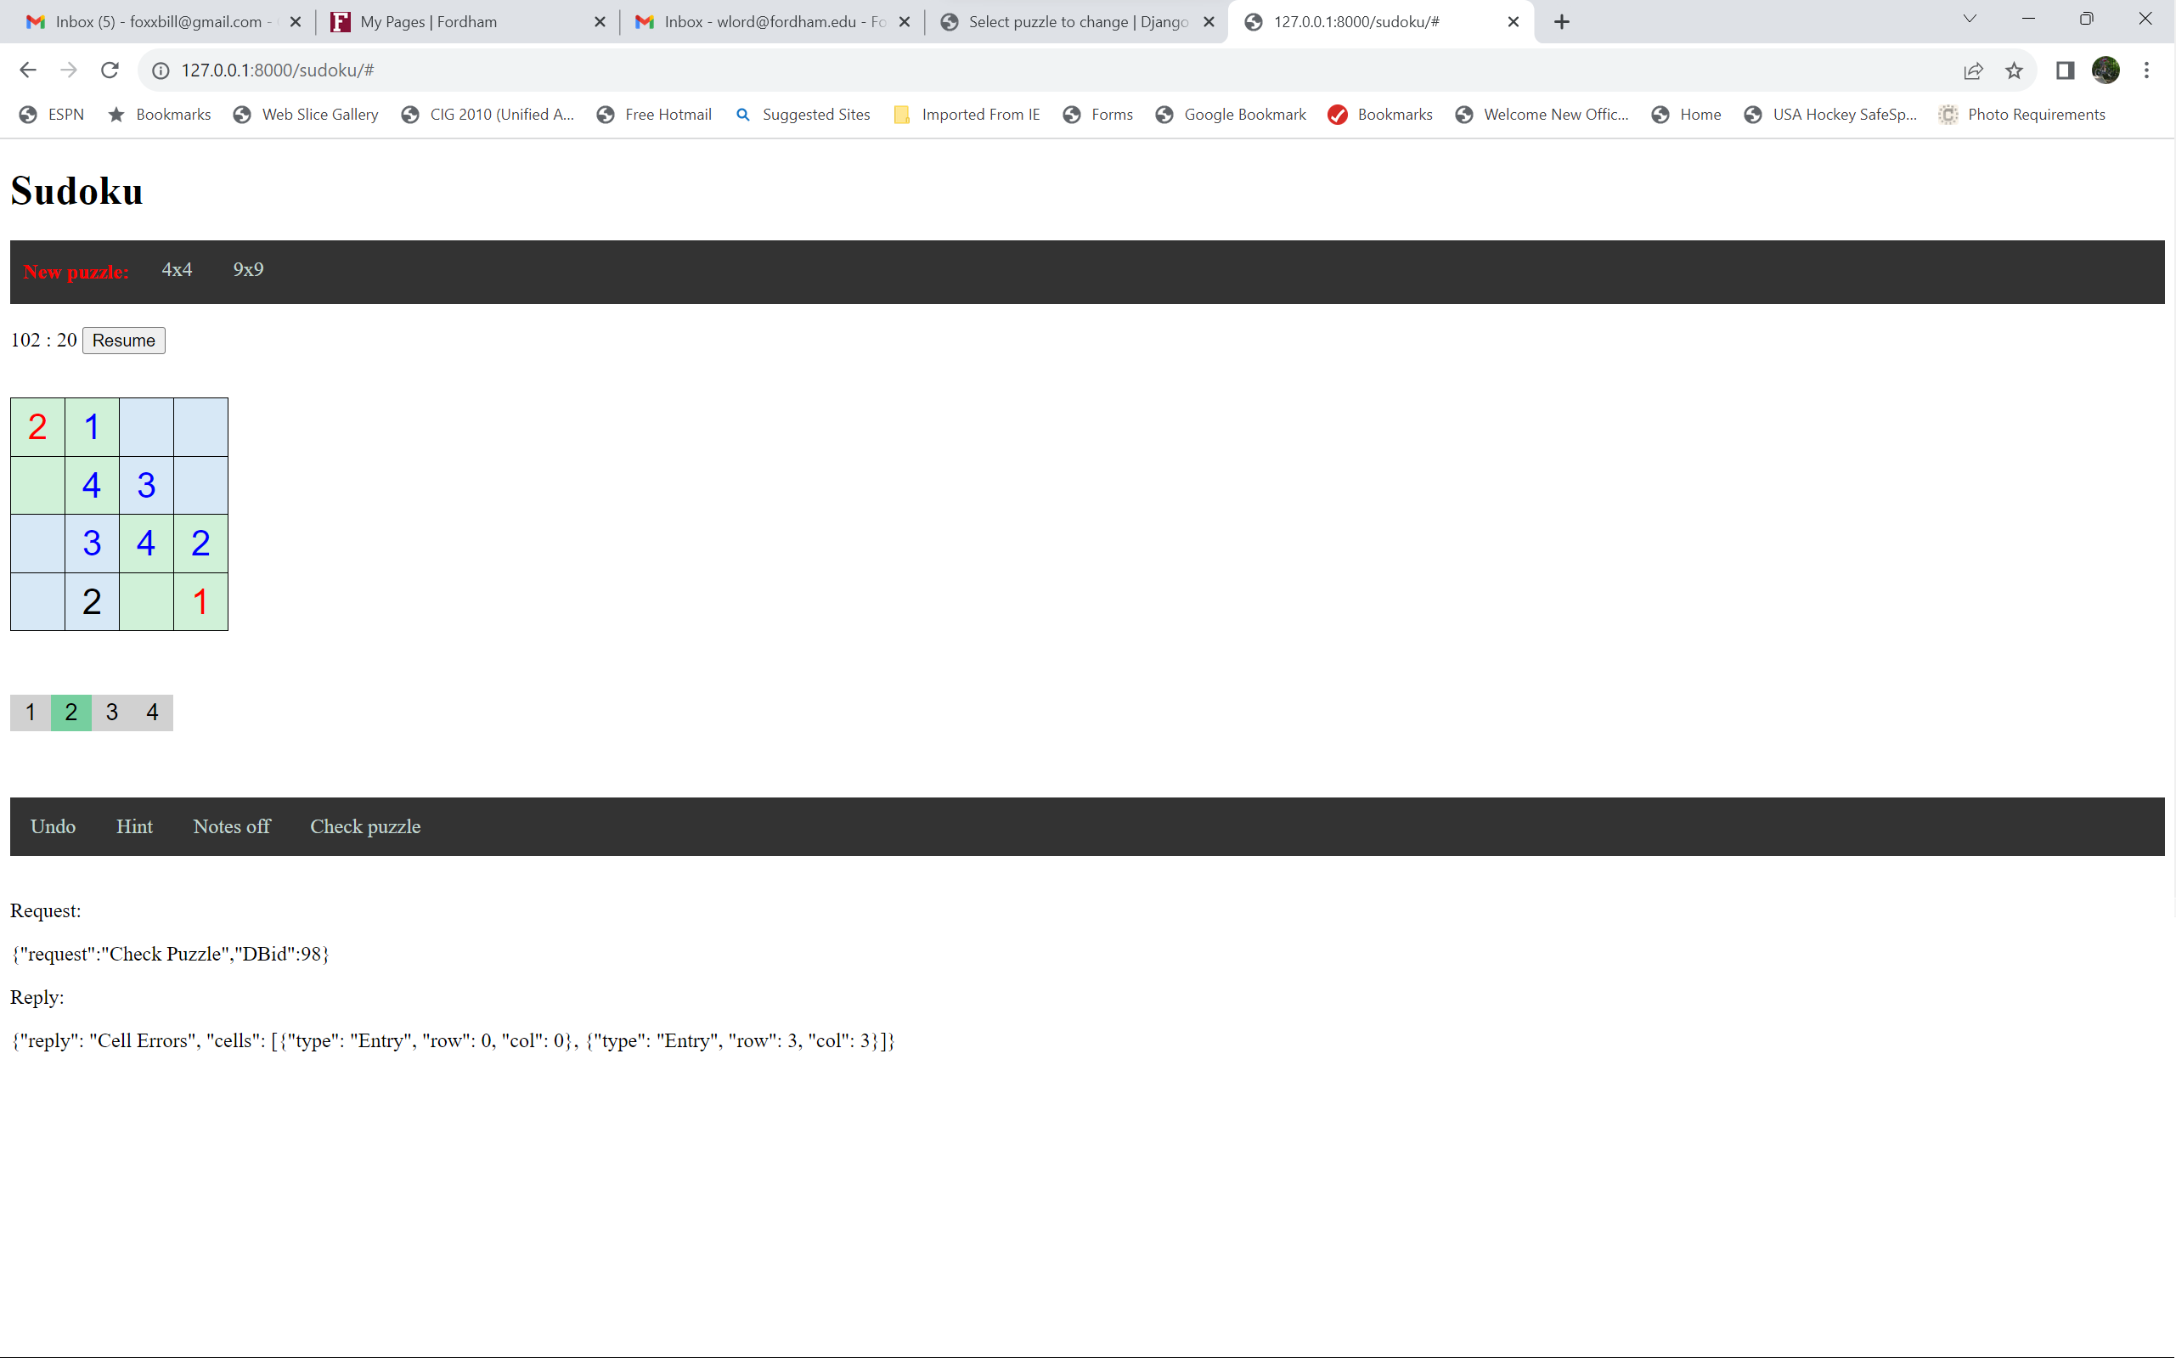
Check puzzle:
All errors will be shown in red
Check puzzle:

Slide 27
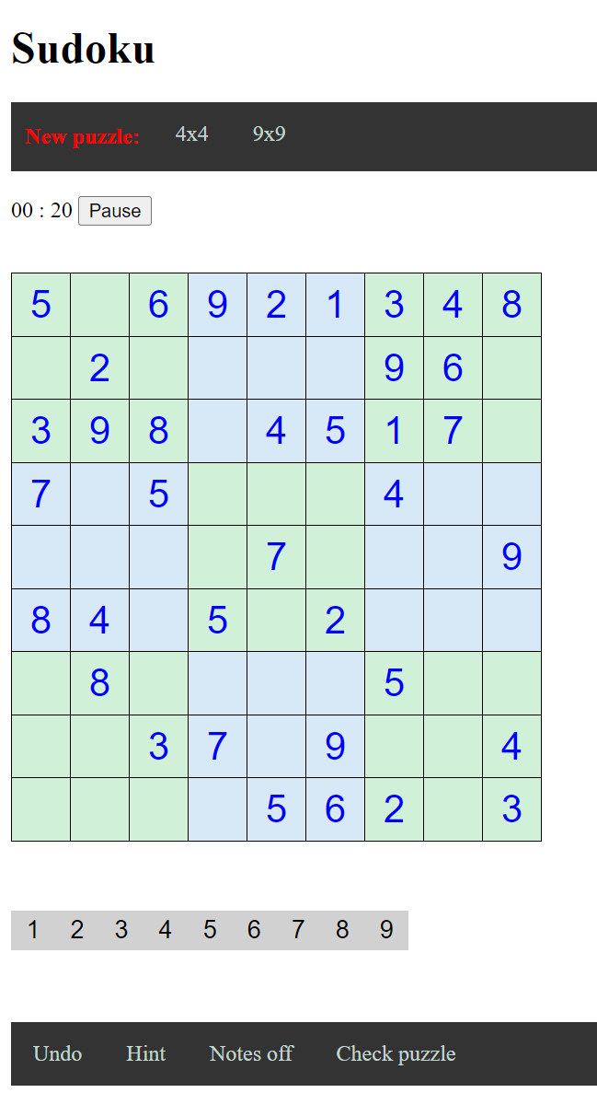
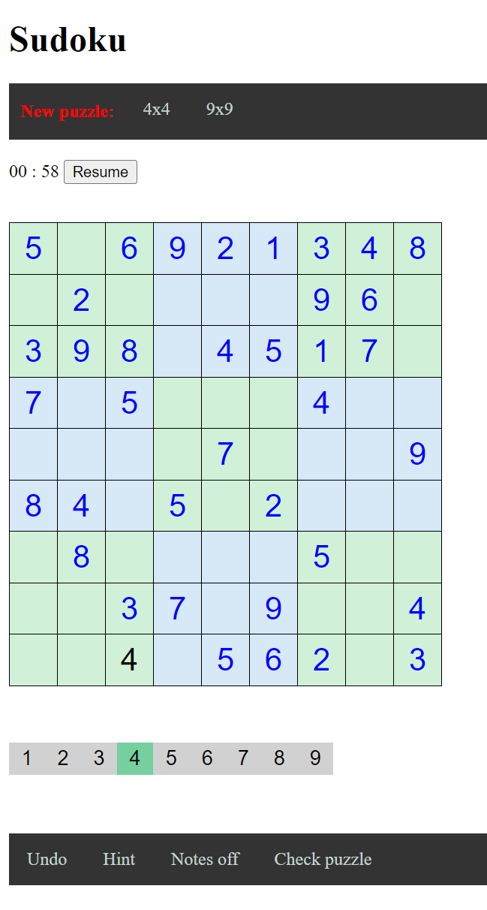
Pause timer:
Toggle between a running and stopped puzzle timer
Timer will restart for a new game
Resume timer:
These storyboards are also available on Blackboard in the “Sudoku project design specs folder.”
This folder will also contain other design documents we create throughout the semester.

Slide 28

Team A
Vanessa
Aryan
Jan Bieniek
Team D
Jason
Robert
Nika
Team B
Jan Bierowiec
Mark
Jonathan
Team E
Moyo
Juliette
Tone
Team F
Prarthana
Gurpreet
Akash
Team C
Michael
Danny
Mintesnot

Slide 29
UML – Unified Modelling Language
Literally, a whole course could be dedicated to UML
Language, yes, but a visual/graphical one
Primarily for people-to-people communication
Not typically for people to computers communication
Spoken and computer language independent
Toolkits readily available
e.g. https://online.visual-paradigm.com

Slide 30
What is UML?
UML is a modeling language to express and design documents, software
Particularly useful for OO design
Independent of implementation language

Slide 31
With credit to:
Introduction to UML, CS A401. What is UML? Unified Modeling Language –OMG Standard, Object Management Group –Based on work from Booch, Rumbaugh, Jacobson.
Published by Magdalen Hudson
https://slideplayer.com/slide/6139612/

Slide 32
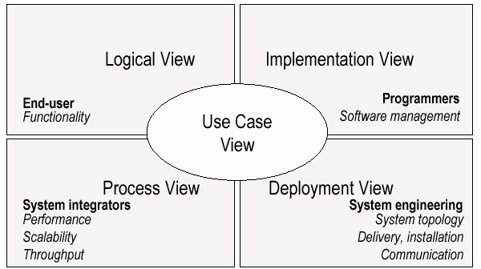
UML Models, Views, Diagrams
UML is a multi-diagrammatic language
Each diagram is a view into a model
Diagram presented from the aspect of a particular stakeholder
Provides a partial representation of the system
Is semantically consistent with other views
Example views

Slide 33
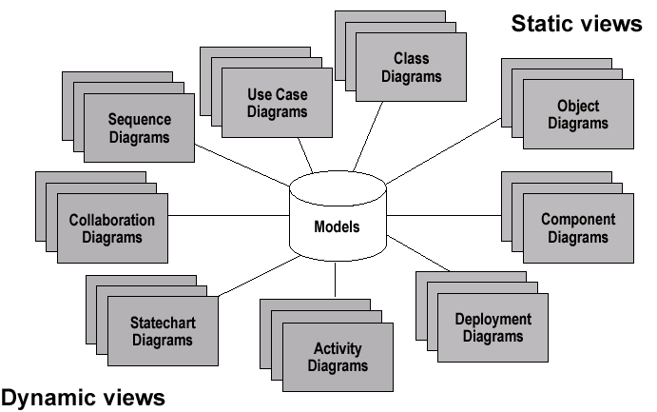
Models, Views, Diagrams

Slide 34

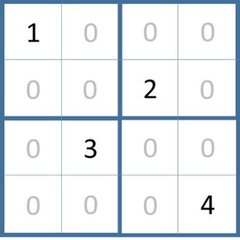
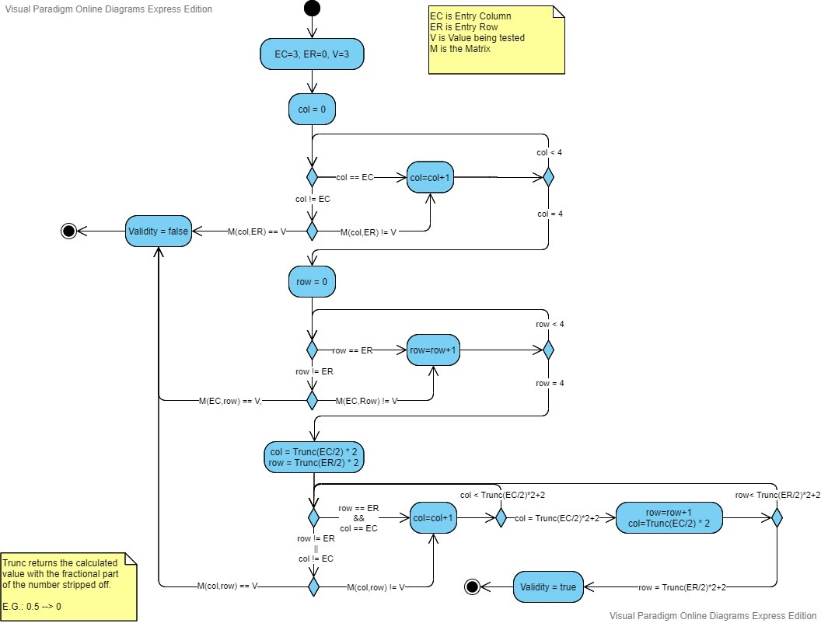
Activity diagram
1. The activity diagram below to derive describes the steps to derive the value of ‘Validity’ upon termination
EC=1, ER=0, V=2
EC=1, ER=3, V=2
EC=2, ER=3, V=3

Slide 35
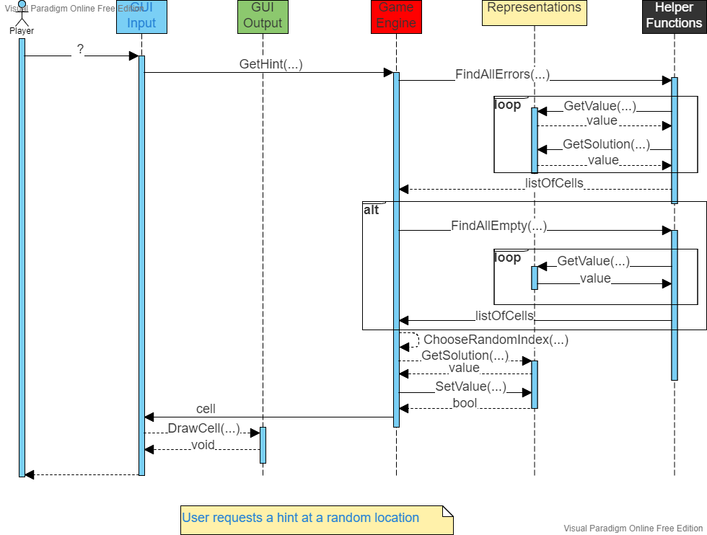
Sequence diagram: Show the main components of a design and how a request communicates (flows) among them to derive an answer.

Slide 36
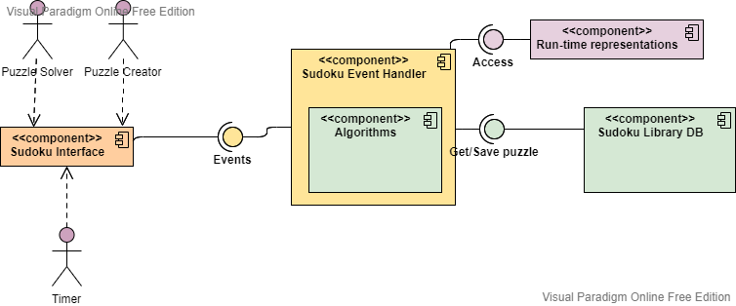
Component diagram: Show the main components of a design their connectivity.

Slide 37
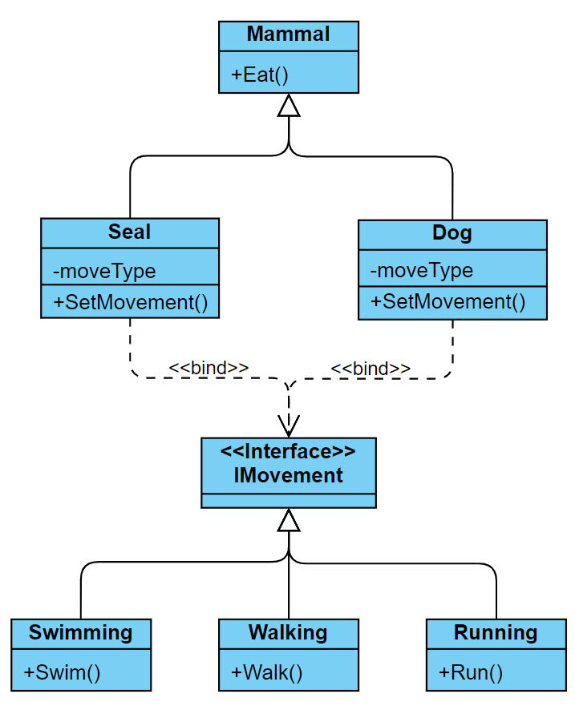
Class diagram: Show the main classes of a program design, their attributes and methods; and how they are related.

Slide 38
Use Case Scenario: Example
Name: Purchase ticket
Participating actor: Passenger
Entry condition:
Passenger standing in front of ticket distributor.
Passenger has sufficient money to purchase ticket.
Exit condition:
Passenger has ticket.
Event flow:
1. Passenger selects the number of zones to be traveled.
2. Distributor displays the amount due.
3. Passenger inserts money, of at least the amount due.
4. Distributor returns change.
5. Distributor issues ticket.
Anything missing?
Exceptional cases!

Slide 39
Use Case Diagrams
Used during requirements elicitation to represent external behavior
Actors represent roles, that is, a type of user of the system
Use cases represent a sequence of interaction for a type of functionality; summary of scenarios
The use case model is the set of all use cases. It is a complete description of the functionality of the system and its environment
Passenger
PurchaseTicket

Slide 40
The <<extends>> Relationship
<<extends>> relationships represent exceptional or seldom invoked cases.
The exceptional event flows are factored out of the main event flow for clarity.
Use cases representing exceptional flows can extend more than one use case.
The direction of a <<extends>> relationship is to the extended use case
Passenger
PurchaseTicket
<<extends>>
<<extends>>
<<extends>>
OutOfOrder
<<extends>>
TimeOut
Cancel
NoChange

Slide 41
The <<includes>> Relationship
<<includes>> relationship represents behavior that is factored out of the use case.
<<includes>> behavior is factored out for reuse, not because it is an exception.
The direction of a <<includes>> relationship is to the using use case (unlike <<extends>> relationships).
Passenger
PurchaseMultiCard
PurchaseSingleTicket
<<includes>>
<<includes>>
<<extends>>
CollectMoney
<<extends>>
NoChange
Cancel

Slide 42
Use Cases are useful to…
Determining requirements
New use cases often generate new requirements as the system is analyzed and the design takes shape.
Communicating with clients
Their notational simplicity makes use case diagrams a good way for developers to communicate with clients.
Generating test cases
The collection of scenarios for a use case may suggest a suite of test cases for those scenarios.

Slide 43
Use case scenario:
Could be done before storyboarding
Good for when requirements aren’t known or clear
Elements of a Use Case
Depending on how in depth and complex you want or need to get, use cases describe a combination of the following elements:
Actor – anyone or anything that performs a behavior (who is using the system)
Stakeholder – someone or something with vested interests in the behavior of the system under discussion (SUD)
Primary Actor – stakeholder who initiates an interaction with the system to achieve a goal
Preconditions – what must be true or happen before and after the use case runs.
Triggers – this is the event that causes the use case to be initiated.
Main success scenarios [Basic Flow] – use case in which nothing goes wrong.
Alternative paths [Alternative Flow] – these paths are a variation on the main theme. These exceptions are what happen when things go wrong at the system level.
How To Write a Use Case
Write the steps in a use case in an easy-to-understand narrative. Kenworthy (1997) outlines the following steps:
Identify who is going to be using the website.
Pick one of those users.
Define what that user wants to do on the site. Each thing the use does on the site becomes a use case.
For each use case, decide on the normal course of events when that user is using the site.
Describe the basic course in the description for the use case. Describe it in terms of what the user does and what the system does in response that the user should be aware of.
When the basic course is described, consider alternate courses of events and add those to "extend" the use case.
Look for commonalities among the use cases. Extract these and note them as common course use cases.
Repeat the steps 2 through 7 for all other users.
From: https://www.usability.gov/how-to-and-tools/methods/use-cases.html

Slide 44
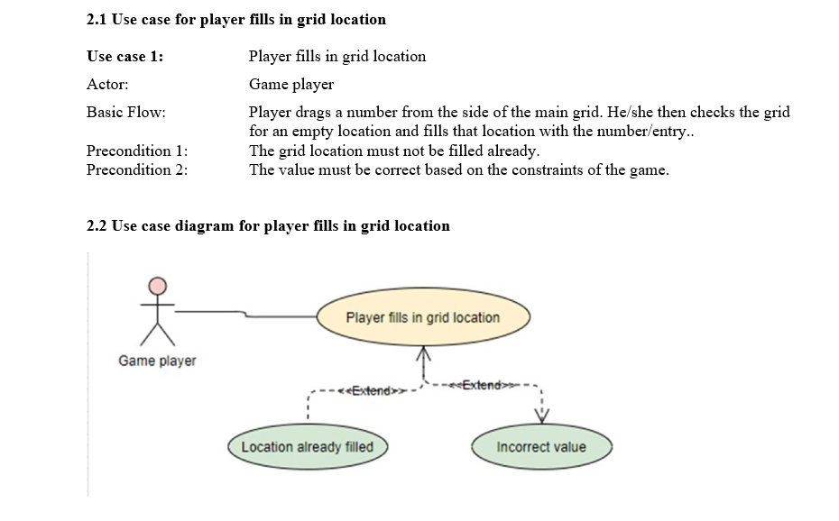
Use case scenario and use case diagram:

Slide 45
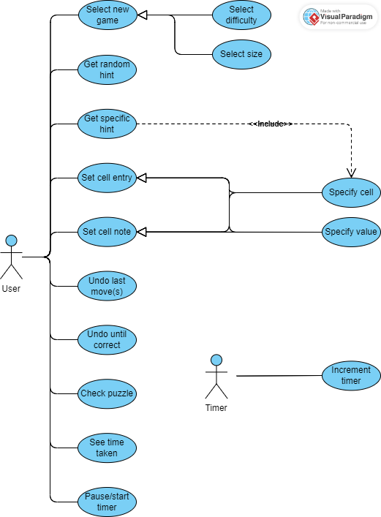
Use Case Diagram (high-level)

Slide 46
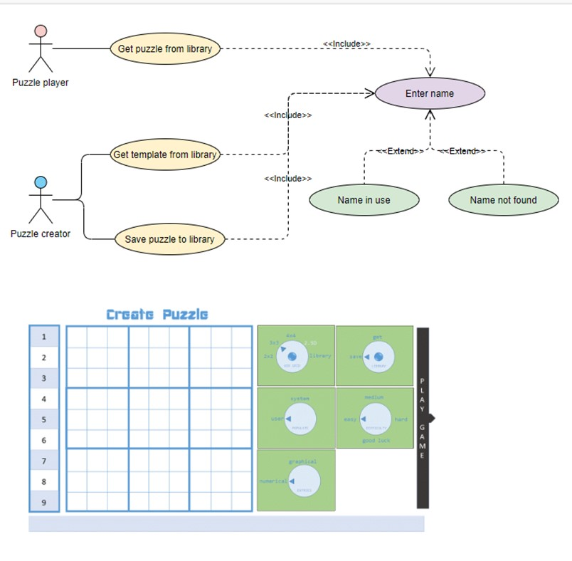
Example from our project – Player or game creator uses the library

Slide 47
UML – Unified Modelling Language
Is UML worth learning?
Learning how to think at higher levels of abstraction is important
Having tools to express higher levels of abstraction is important
Showing higher levels of abstraction in code is difficult, in UML it is easy
The larger the project, the higher the need for formal specifications
The chances that your (next) job will use it are low (20 in 1000, or 2%)
As projects using UML progress, the UML specs and actual program diverge
If used, the whole team must learn it.
Customers typically won’t know it

Slide 48
Class exercise
A
Write a use case scenario for the use case indicated for your team
B
Elements of a Use Case
Depending on how in depth and complex you want or need to get, use cases describe a combination of the following elements:
Actor – anyone or anything that performs a behavior (who is using the system)
Stakeholder – someone or something with vested interests in the behavior of the system under discussion (SUD)
Primary Actor – stakeholder who initiates an interaction with the system to achieve a goal
Preconditions – what must be true or happen before and after the use case runs.
Triggers – this is the event that causes the use case to be initiated.
Main success scenarios [Basic Flow] – use case in which nothing goes wrong.
Alternative paths [Alternative Flow] – these paths are a variation on the main theme. These exceptions are what happen when things go wrong at the system level.
How To Write a Use Case
Write the steps in a use case in an easy-to-understand narrative. Kenworthy (1997) outlines the following steps:
Identify who is going to be using the website.
Pick one of those users.
Define what that user wants to do on the site. Each thing the use does on the site becomes a use case.
For each use case, decide on the normal course of events when that user is using the site.
Describe the basic course in the description for the use case. Describe it in terms of what the user does and what the system does in response that the user should be aware of.
When the basic course is described, consider alternate courses of events and add those to "extend" the use case.
Look for commonalities among the use cases. Extract these and note them as common course use cases.
Repeat the steps 2 through 7 for all other users.
C
D
E
H
F
G

Slide 49
Process Models

Slide 50
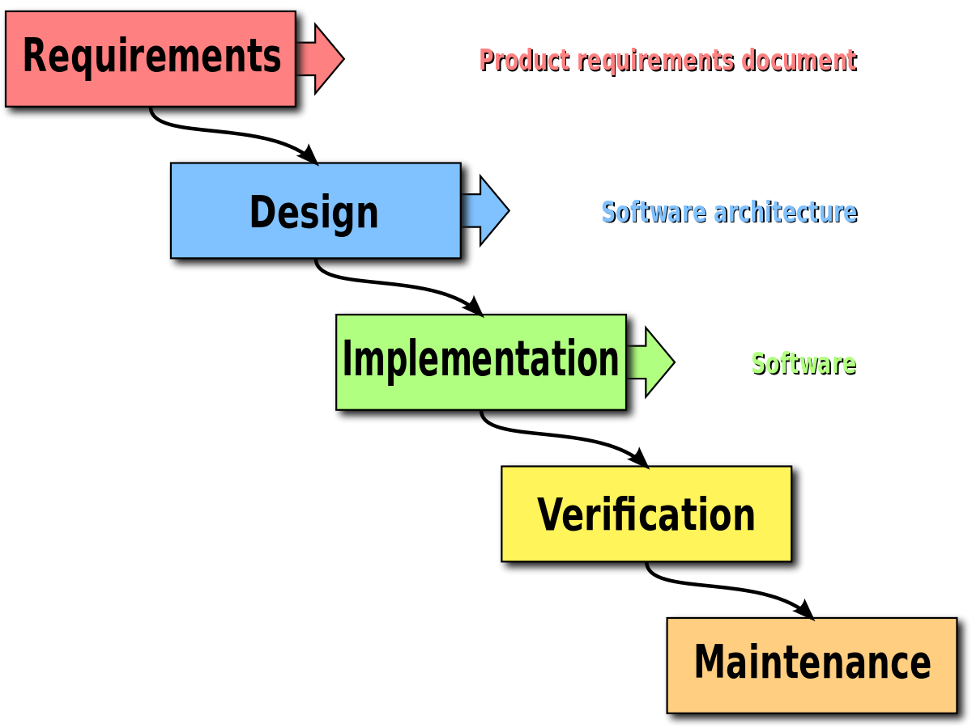
Waterfall Model
Pros
Time spent early in a SDLC can reduce costs at later stages (e.g. bug fix later can be 50-200 times more expensive)
More emphasis on complete design and documentation making it easier for adding or changing team members
Easy to understand and translates easily to milestones (project management)
Best when there are strict requirements, fixed scope, and the product is firm and stable and its technology is clearly understood.
Cons
Clients may not fully understand their requirements before they see working software
Designers may not be aware of future difficulties
“Some organisations, such as the United States Department of Defense, now have a stated preference against waterfall-type methodologies, starting with MIL-STD-498, which encourages evolutionary acquisition and Iterative and Incremental Development.[15]”
Material from or adapted from Wikipedia

Slide 51
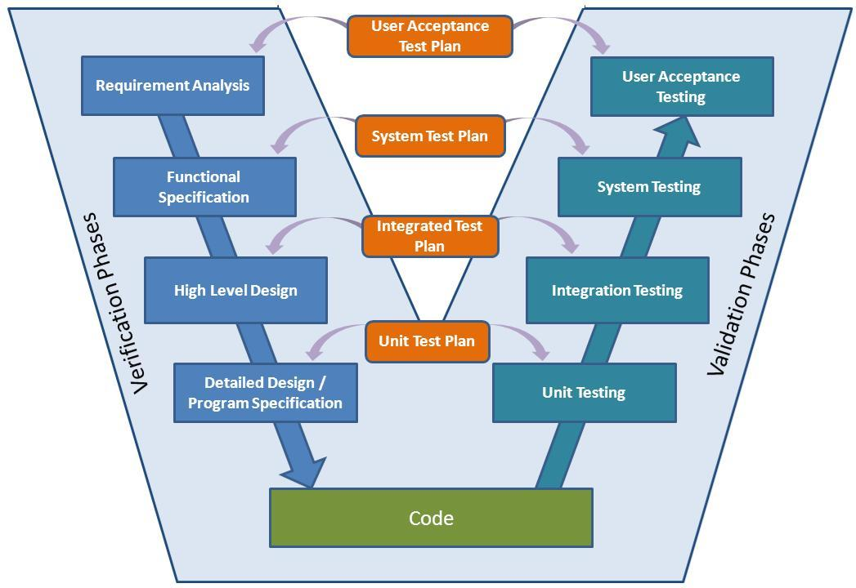
Pros
Adds explicit testing to the waterfall model (both test design and implementation)
Has been adopted by the medical device industry
V-Model
Cons
All testing is after coding
Most of the pitfalls of the waterfall model
Overly simplified
Attribution: http://www.softwaretestingstudio.com/v-model-software-development/ and https://en.wikipedia.org/wiki/V-Model_(software_development)

Slide 52
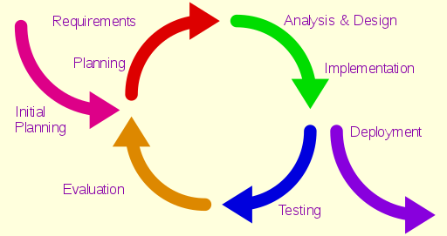
Iterative Model
Pros
Best when a product’s functionality can be rolled out over time
Involves frequent feedback from customers and/or market
Faster (initial) time to market
Cons
Can lead to legacy code that is hard to continue working with
Can lead to code full of patches
By Aflafla1 - Iterative development model V2.jpg , User:Westerhoff, CC0, https://commons.wikimedia.org/w/index.php?curid=34159246

Slide 53
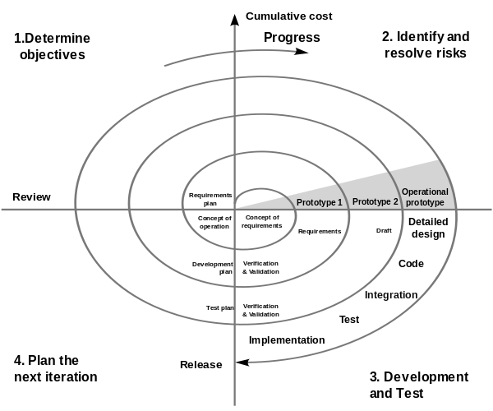
Spiral Model
Pros
Like the iterative model but with a strong philosophical background to perform risk analysis for each iteration
Cons
Using the diagram without understanding the underlying philosophy can lead to all the pitfalls of the iterative model, i.e. so called “hazardous spiral look-alike” processes
Conny derivative work: Spiral_model_(Boehm,_1988).png: Marctroy derivative work: Conan (talk) - File:Spiralmodel_nach_Boehm.png, Spiral_model_(Boehm,_1988).png

Slide 54
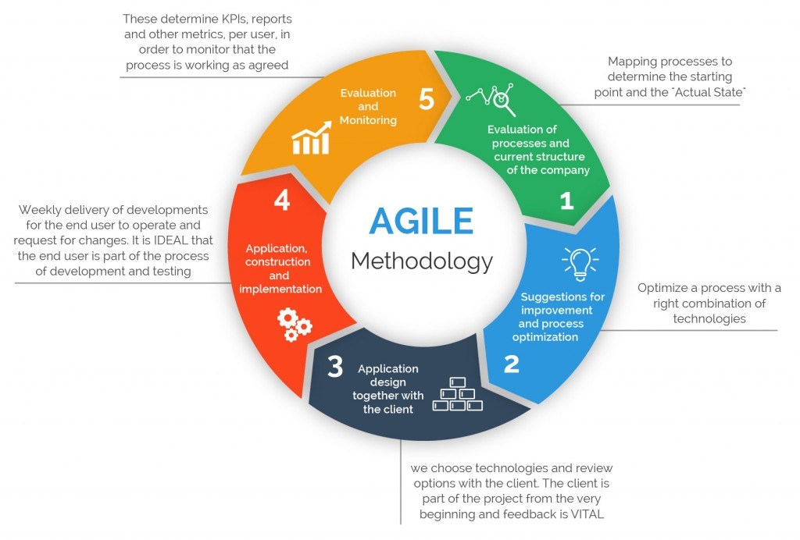
Agile
Pros
Very customer oriented
Can help to very quickly launch product iterations
Allows for change
Cons
Desired degree of customer involvement can be (too) high
May lead to frequent refactoring
Potentially inefficient in large organizations
Criticized as being a management fad
Attribution: https://www.360logica.com/blog/the-importance-of-different-agile-methodologies-included-in-agile-manifesto/
https://en.wikipedia.org/wiki/Agile_software_development#Criticism
https://www.seguetech.com/waterfall-vs-agile-methodology/

Slide 55
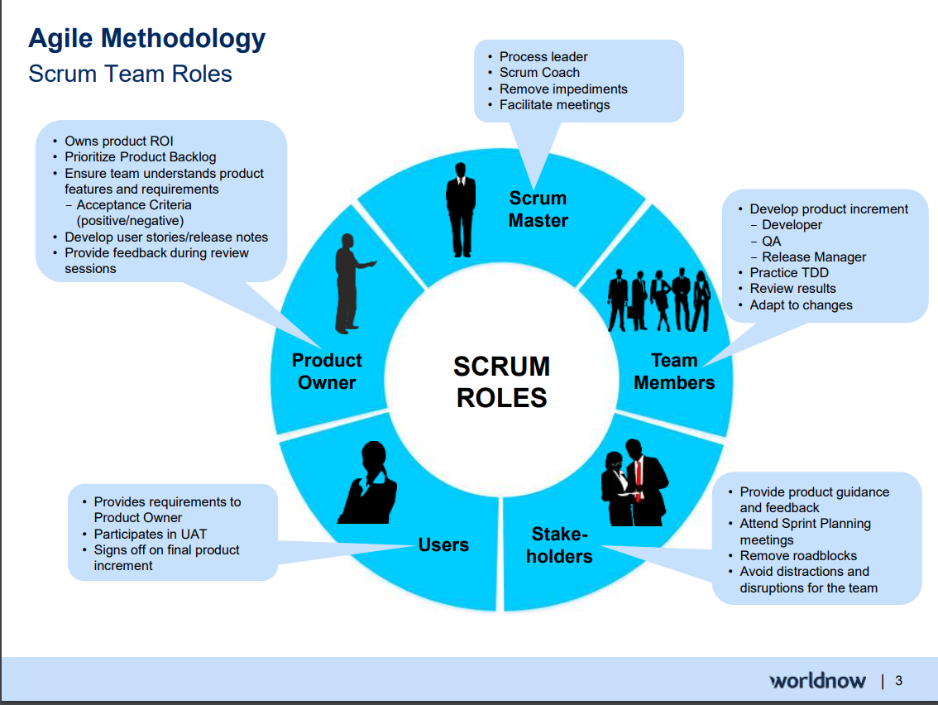
Attribution: https://www.slideshare.net/SandyLee9/agile-methodology-assessment-73719466

Slide 56

Prototype
Pros
Very customer oriented
Helpful when design decisions are not well known
Can produce reusable code for final implementation
Cons
Can overwhelm developers if customers can’t make decisions
The prototype may not consider technical feasibility and scalability issues that can arise during the final product development.
Reusing prototype code may lead to a sub-optimal solution
Attribution: https://www.geeksforgeeks.org/software-engineering-prototyping-model/
Sudoku example
Research example

Slide 57
Homework
Read in Software Engineering: A Practitioner’s Approach
Chapter 7 through 7.4 -- Understanding Requirements
Chapter 2 – Process Models
In Appendix A on UML
Use-Case diagrams
Sequence diagrams
Turn your team exercise into a document that will (after vetting and reformatting) will be shared as a design document.

Slide 58
Project time
Break into your teams:
Exchange contact information
Discuss ways of interacting
Github
Shared code
Shared documents
Make readable by me: profwpl
Slack?
Discuss parts of overall architecture and relevant backgrounds of team members

Slide 59



Requirements
For looking at requirements let’s consider these very different applications :

Slide 60

Requirements
Specific Functional Requirements
Are all the tasks the user wants to perform specified?
Tasks versus input
Is the data used in each task and the data resulting from each task specified?
Are all the inputs to the system specified, including their source, accuracy, range of values, and frequency?
Are all the outputs from the system specified, including their destination, accuracy, range of values, frequency, and format?
Are all the external communication interfaces specified, including handshaking, error-checking, and communication protocols?
From: Code Complete: A Practical Handbook of Software Construction
Steve McConnell
Second edition
McConnell Microsoft Press 2004
ISBN 0-7356-1967-0

Slide 61
Requirements
Specific Nonfunctional (Quality) Requirements
Is the expected response time, from the user's point of view, specified for all necessary operations, including:
processing time, data transfer rate, and system throughput?
Is the level of security specified?
Is the reliability specified, including the consequences of software failure, the vital information that needs to be protected from failure, and the strategy for error detection and recovery?
Is the maintainability of the system specified, including its ability to adapt to changes in specific functionality, changes in the operating environment, and changes in its interfaces with other software?
Is the definition of success included? Of failure?
From: Code Complete: A Practical Handbook of Software Construction
Steve McConnell
Second edition
McConnell Microsoft Press 2004
ISBN 0-7356-1967-0

Slide 62
Requirements
Requirements Quality
Are the requirements written in the user's language?
Do the users think so?
Does each requirement avoid conflicts with other requirements?
Are acceptable tradeoffs between competing attributes specified—for example, between robustness and correctness?
Do the requirements avoid specifying the design?
Are the requirements at a fairly consistent level of detail? Should any requirement be specified in more detail? Should any requirement be specified in less detail?
Are the requirements clear enough to be turned over to an independent group for construction and still be understood? Do the developers think so?
Is each requirement testable?
From: Code Complete: A Practical Handbook of Software Construction
Steve McConnell
Second edition
McConnell Microsoft Press 2004
ISBN 0-7356-1967-0

Slide 63
Requirements
Requirements Completeness
Where information isn't available before development begins, are the areas of incompleteness specified?
Are the requirements complete in the sense that if the product satisfies every requirement, it will be acceptable?
From: Code Complete: A Practical Handbook of Software Construction
Steve McConnell
Second edition
McConnell Microsoft Press 2004
ISBN 0-7356-1967-0

